Slide 1
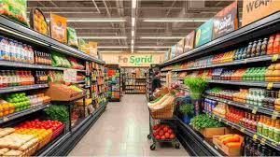
Store Sales Smart Retail Intelligence System Inventory & Sales Analytics Project
by:
ABDULMUMIN MUHAMMAD SALIS
SUPERVISED BY: UZOMA EWURUM

Slide 2

Project overview
A data-driven retail intelligence system that analyzes sales and inventory to detect stock risks, identify high and low-performing products, and forecast demand. It enables smarter, faster, and more profitable decision-making for retail store owners.

Slide 3

Problem statement
Retail stores frequently lose revenue due to poor inventory decisions. Products run out too quickly or remain unsold for too long. Most small businesses rely on guesswork instead of data, leading to inefficiency, waste, and missed opportunities.

Slide 4

Project Objective
Monitor store performance
Detect overstock and out-of-stock risk
Identify best and low selling products
Analyze daily/monthly sales
Forecast future sales
Predict days remaining to restock

Slide 5

Tools Used
Excel
CSV
SQL
Python
Power BI
PowerPoint

Slide 6

Dataset Description
Inventory Sheet
Categories
Products
Stocked
Sales datasets
Date
Categories
Products
Dates
Quantity
Price

Slide 7

Inventory analysis
Classifies stocks into:
Low Stock
Overstock
Normal
Based on Re-order %

Slide 8

Data Cleaning
Standardized category names
Standardized product names
Fixed date formats
Handled mismatches

Slide 9

KPI Summary
Total units sold
Number of products
Best-selling product
Lowest-selling product
Overstock count
Low stock count

Slide 10

Inventory Status
Remaining stock
Re_stock %
Restock Alerts

Slide 11

Sales analysis
Identified:
Top-selling products
Low-selling products
Analyzed:
Daily trends
Monthly trends

Slide 12
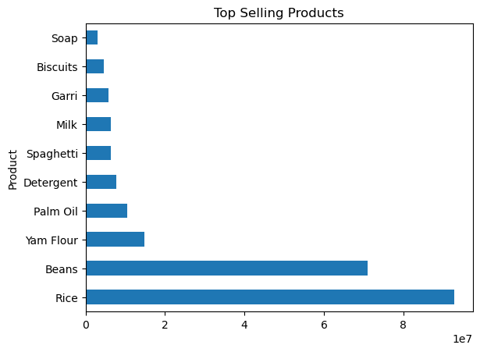
Best Sellers
Top-performing products drive the majority of sales and should be prioritized for restocking.

Slide 13
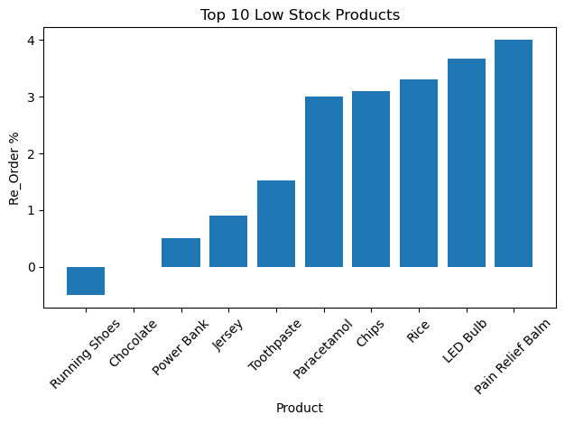
Low Stocks
Low-selling products contribute minimally to revenue and may require promotion or reduced stocking.”
I identifies items that are underperforming in the store.
9 Products Near Stockout — Immediate Restock Required

Slide 14
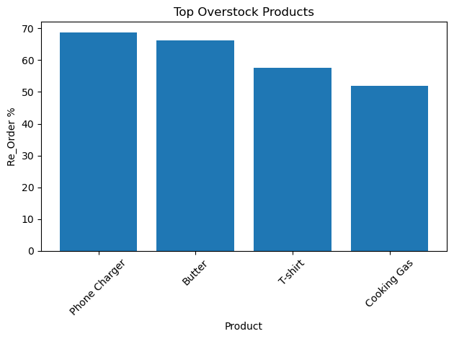
Overstocked
Excess inventory is tied to low-demand products, increasing storage costs and tying up capital.”
Helps identify inefficiencies in purchasing decisions.

Slide 15
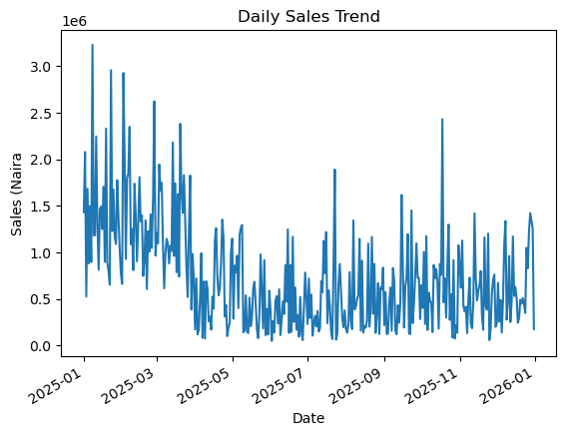
Daily Sales Trend
Sales peak during specific days, revealing clear customer purchasing patterns.

Slide 16
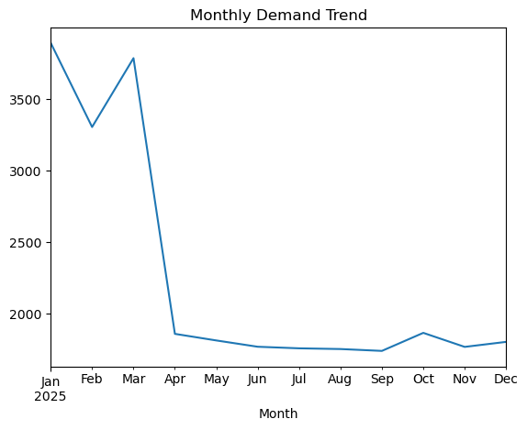
Monthly Sales Trend
Sales show noticeable fluctuations across months, indicating changing demand trends

Slide 17
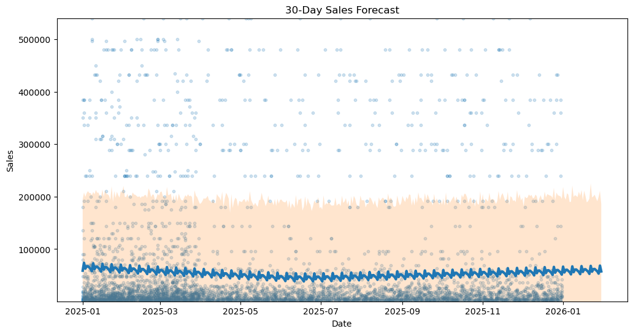
Forecast
Predicted sales trends help anticipate demand and prepare inventory in advance.
Scatter Points (Light Blue Dots)=Actual sales transactions
Dark Blue Line (Forecast Trend)= Predicted average sales (yhat)
Shaded Area (Confidence Interval)= Uncertainty range

Slide 18
Smart Alert (Days remaining)
Product | Current Stock | Days Remaining | SMART ALERT
0 | Running Shoes | -1 | -0.169154 | URGENT RESTOCK
1 | Chocolate | 0 | 0.000000 | URGENT RESTOCK
2 | Power Bank | 1 | 0.170854 | URGENT RESTOCK
3 | Jersey | 2 | 0.330275 | URGENT RESTOCK
4 | Paracetamol | 6 | 0.927835 | URGENT RESTOCK
5 | Pain Relief Balm | 8 | 1.291667 | URGENT RESTOCK
6 | LED Bulb | 11 | 1.712803 | URGENT RESTOCK
7 | Wristwatch | 20 | 4.000000 | URGENT RESTOCK
8 | Toothpaste | 26 | 4.379928 | URGENT RESTOCK
9 | Extension Box | 27 | 5.150289 | RESTOCK SOON
Products with less than a few days remaining require immediate restocking action.
Displays:
Current stock
Days remaining
Smart alerts (Urgent / Soon)

Slide 19

Key Insights
Some products frequently go out of stock
Some products are overstocked
Sales trends vary across time

Slide 20

CONCLUSION
System improves decision making
Reduces stock issues
Increases efficiency
Supports smart retail management

Slide 21

Recommendations
Reduce purchase quantity for overstocked products
Reorder high-demand products earlier
Promote low-selling products
Monitor fast-moving skus weekly

Slide 22

FUTURE IMPROVEMENTS
Machine Learning prediction
Automated ordering system
Real-time dashboard
Alert System
SMS alerts
Email notifications

Slide 23
Thank you for listening!!!

